Slide 1
Operators in Java

Slide 2
Operators in Java
Operator in Java is a symbol that is used to perform operations. For example: +, -, *, / etc.
There are many types of operators in Java which are given below:
Unary Operator,
Arithmetic Operator,
Shift Operator,
Relational Operator,
Bitwise Operator,
Logical Operator,
Ternary Operator and
Assignment Operator.

Slide 3
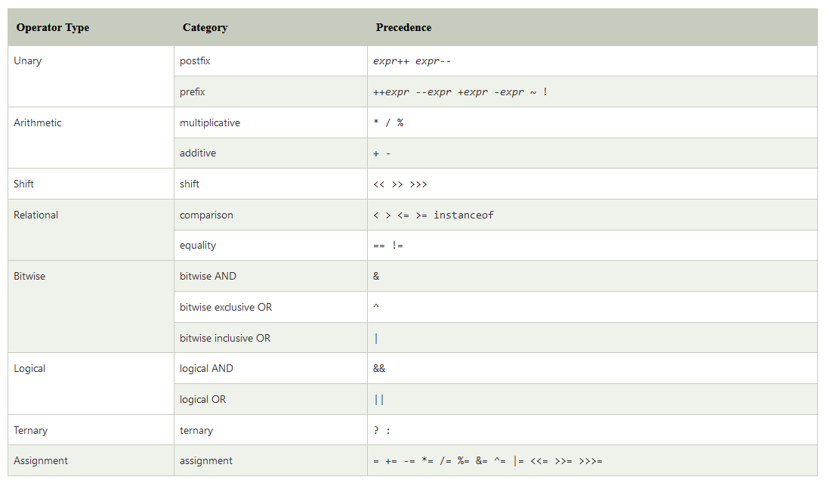
Types of Java Operator

Slide 4
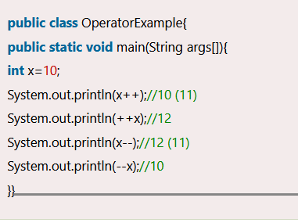
Java Unary Operator
The Java unary operators require only one operand. Unary operators are used to perform various operations i.e.:
incrementing/decrementing a value by one
negating an expression
inverting the value of a boolean

Slide 5
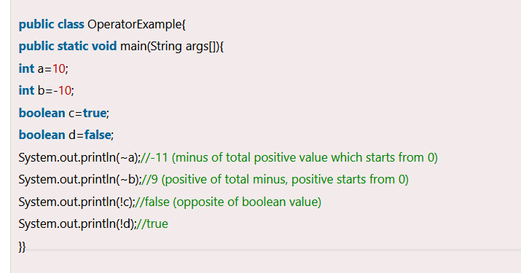
Java Unary Operator Example: ~ and !

Slide 6
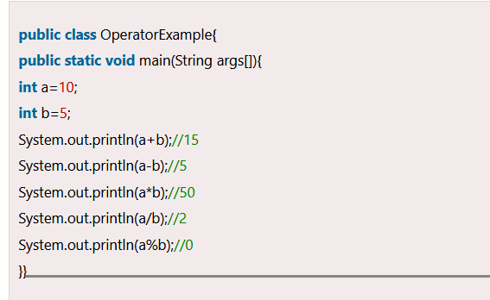
Java Arithmetic Operators

Slide 7
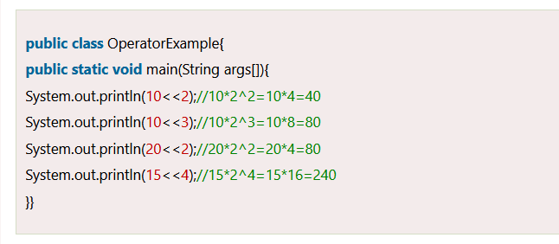
Java Left Shift Operator
The Java left shift operator << is used to shift all of the bits in a value to the left side of a specified number of times.

Slide 8
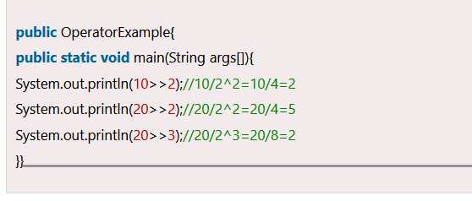
Java Right Shift Operator
The Java right shift operator >> is used to move the value of the left operand to right by the number of bits specified by the right operand.

Slide 9
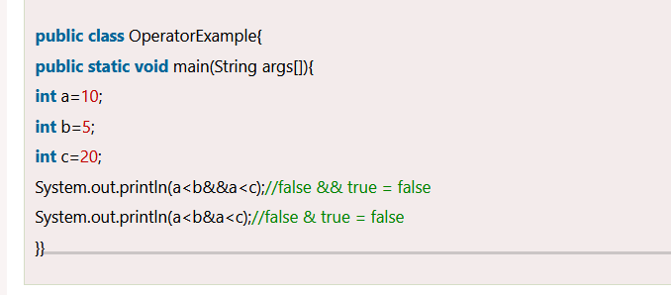
Java AND Operator Example: Logical && and Bitwise &
The logical && operator doesn't check the second condition if the first condition is false. It checks the second condition only if the first one is true.
The bitwise & operator always checks both conditions whether first condition is true or false.

Slide 10
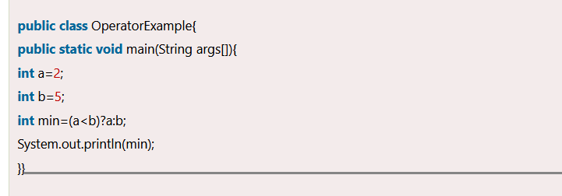
Java Ternary Operator
Java Ternary operator is used as one line replacement for if-then-else statement and used a lot in Java programming. It is the only conditional operator which takes three operands.

Slide 11
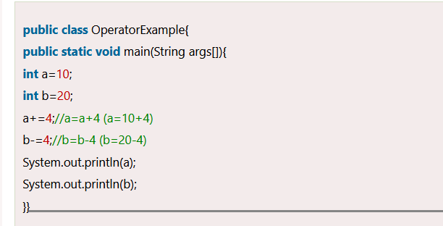
Java Assignment Operator
Java assignment operator is one of the most common operators. It is used to assign the value on its right to the operand on its left.

Slide 12
Logical Operators in Java
Logical operators are used to perform logical “AND”, “OR” and “NOT” operations, i.e. the function similar to AND gate and OR gate in digital electronics. They are used to combine two or more conditions/constraints or to complement the evaluation of the original condition under particular consideration. One thing to keep in mind is, while using AND operator, the second condition is not evaluated if the first one is false. Whereas while using OR operator, the second condition is not evaluated if the first one is true, i.e. the AND and OR operators have a short-circuiting effect. Used extensively to test for several conditions for making a decision.
AND Operator ( && ) – if( a && b ) [if true execute else don’t]
OR Operator ( || ) – if( a || b) [if one of them is true to execute else don’t]
NOT Operator ( ! ) – !(a<b) [returns false if a is smaller than b]

Slide 13
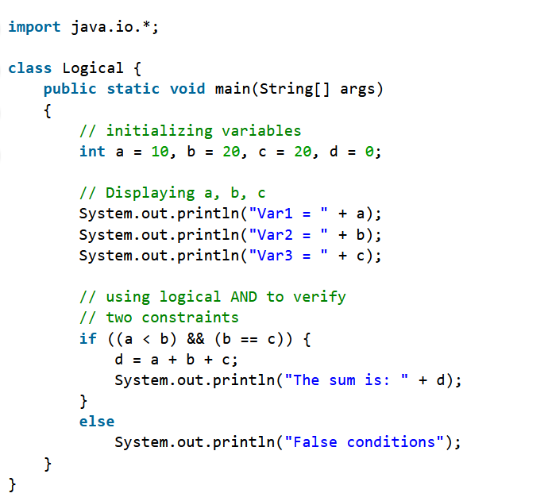
Logical And Operator
This operator returns true when both the conditions under consideration are satisfied or are true. If even one of the two yields false, the operator results false. In Simple terms, cond1 && cond2 returns true when both cond1 and cond2 are true (i.e. non-zero).

Slide 14
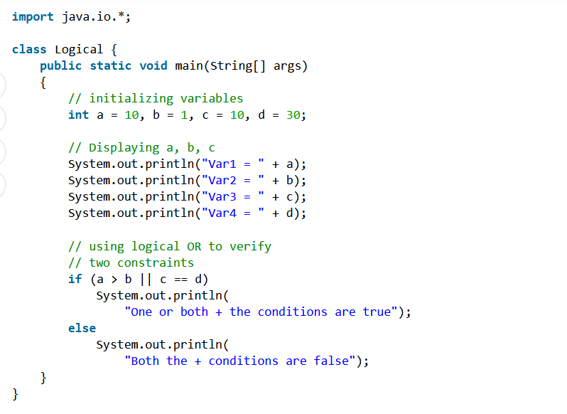

Logical OR Operator
This operator returns true when one of the two conditions under consideration is satisfied or is true. If even one of the two yields true, the operator results true. To make the result false, both the constraints need to return false.
Syntax

